Slide 1
Lecture 1: Introduction to Programming
Dr. Tsung-Wei Huang
Department of Electrical and Computer Engineering
University of Utah, Salt Lake City, UT
Notes:
We are about to start - please mute yourself, unless you have questions.
Good morning, everyone. Welcome to CS 1410 section 40 - Object-oriented Programming. I am the course instructor Tsung-Wei Huang, and you can just call me TW, which is much easier to remember.
I am faculty member at the ECE department and my research helps parallel programming easier to handle. And, thanks for taking this course and I think it is quite challenging this semester because I know many of you have just graduated from high school and now are facing all the difficult situations due to COVID-19. Because of that, this course will be offered completely online at the scheduled time.
Since we have many students, I hope the internet will not be a problem. To accommodate that, I will record the lecture, and the video will be available on the class page after the class.

Slide 2
The course teaches you how to write basic computer programs with a specific focus on the C++ programming language.
Notes:
The course is going to teach you ...
You probably already know, software programming is critical to advance your career. Literally, all kinds of jobs in CS or ECE market require certain levels of programming experience. For example, if you want to find a job in Google, you must know how to write software. That means, you will need to write computer programs and ask the computer to do something for you.

Slide 3
Class Logistics
Staff
Instructor: Dr. Tsung-Wei Huang (tsung-wei.huang@utah.edu)
TA 1: Dian-Lun Lin (dian-lun.in@utah.edu)
TA 2: Yasin Zamani (yasin.zamani@gmail.com)
Main class
8:05 AM – 9:25 AM Mon/Wed (excluding holiday)
Zoom: https://utah.zoom.us/j/2468214418
Lab MEB 2555
Friday Morning (8:30 AM – 1:45 PM over sections 41-45)
Office hour
1-3 PM Wed at MEB 2124
Web: https://github.com/tsung-wei-huang/cs1410-40
Notes:
class logistics. We have only one instructor and that is myself. We will have two TAs, Dian-Lun Lin and Yasin; I have put down our emails so you can reach out to us if you have any questions.
The main class takes place twice weekly. ....
We will also have physical LAB that will take place in MEB 2555
You can find me at my office hour, every Wed from 1 to 3 pm at MEB 2124, that is a room nearby the main department office. You can also meet me by appointment.
Webpage. We will use GitHub to manage the class. You can go visit the page or find the link at the my website. You can check out the class materials from the repository. We use GitHub because it allows everybody to easily keep track of all changes and updates to the class materials.

Slide 4
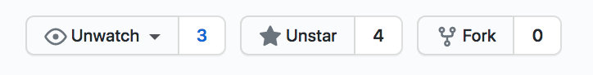
Watch the GitHub Repository
https://github.com/tsung-wei-huang/cs1410-40
You can receive all updates
New homework
New check-in data
New updates
… (please register for a GitHub account)
Canvas will be auxiliary
Notes:
I kindly ask everyone of you to register for a GitHub account. Once you register for a GitHub account, you can log in your page, go to the class GitHub page, and watch the repository. You will be able to see a link on the top-right page for you to click on to watch the page so you can receive all updates, including ...

Slide 5
Scoring
Total 120 points
Weekly programming assignments (PA): 40%
Weekly lab participation (LA): 40%
Take-home exams: 40%
Academic integrity
We trust you but don’t take it for granted
Violation will be recorded in your transcript
https://regulations.utah.edu/academics/6-400.php
Textbook
No need to buy any textbook
Notes:
In terms of scoring, there will be a total of 120 points with three major parts going to (1) weekly ... (2) ... (3) two take-home exams, one midterm and one final. Take-home exams means, when time arrives, I will release the problem to the class website; definitely, they will be programming questions. You will take those questions and solve them offline in approximately three-day window. Using internet to find the solution is completely acceptable because being able to find a solution using the web is also a critical technique you need to have to master programming. And it is actually more important.
Of course, there shouldn’t be any cheating especially in the assignment. You cannot copy the solution from others or from your friends. Every body has his or her own coding style and convention, right? You may name a variable in a way that is completely different from others or structure your code in your own taste. It's easy to find someone cheating if you just copy and paste solutions from somewhere.

Slide 6
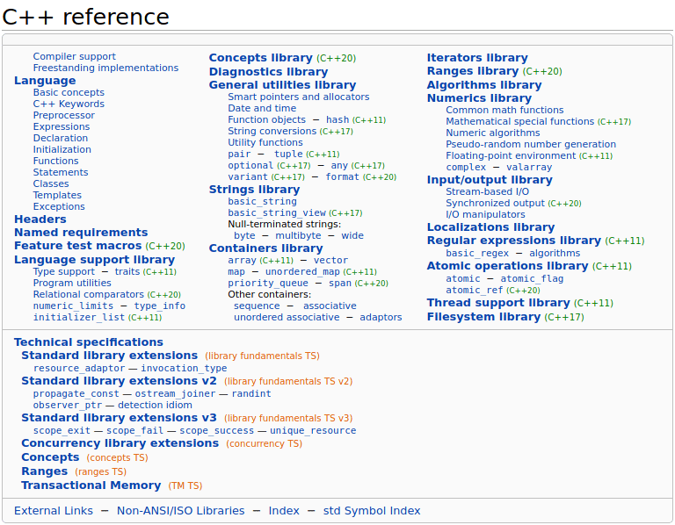

Learning Materials
You DON’T NEED to buy any textbook
Slides will be available and are enough
Google can help you find literally all answers
I never use any textbook in learning C++
Programming requires “practice” not just reading
Useful C++ reference
Cpp reference: https://en.cppreference.com/w/
CppCon: https://www.youtube.com/user/CppCon
Notes:
In this class, you don’t need a reference book. Slides will be available to the GitHub and they are enough. Like I said, the most effective way to learn programming is to practice it, write code for each of the assignments. You will not become a good programmer or a software engineer without writing any code or by just reading a book.
So, slides ...

Slide 7
Class Philosophy
Focus on software programming
With applications on ECE problems
With focus on the C++ programming language
NOT to trouble you with
Difficult homework
Tricky exams
Unreasonable learning and scoring curve
At the end of the class, I want you to
Understand important ECE programming problems
Improve your coding skills and algorithm knowledge
Have more job opportunities in software companies
Notes:
Philosophy of the class. This class is going to focus on software programming a lot, with applications on solving computer design problems. At the same time, we want you to become a good programmer. A good programmer means a lot. It is not just writing fast code with good algorithms and efficient data structure, but also the ability to let people use, read, and reproduce your idea. If you want to become a good programmer, you can't just sit in front of your own editor and write code, you must work with other. try to find information on the internet to come up with your own solutions, try to publish your code on the GitHub so other people can use it and give you feedback.
So, this class is definitely not going to trouble you with ... (articulate the following items)

Slide 8
To this end …
Each class is organized as two parts
Lecture
Programming practice
We will start from very basic stuff and then move up
Important
Basic data structure and algorithms
C++ coding techniques and best practice
Solve real-world computer design problems in C++
Program on microcontroller
Program circuit design problems
…
Notes:
To make this happen, each class is organized to two parts. First part will be a normal lecture, you know, cover some essential concepts, algorithm, data structures, and computer design problems and applications. Second part will be programming practice. I will design relevant questions to these concepts as programming practice. If time is allowed, you will need to work on those questions, write code, and apply the class knowledge to the actual implementation. Or otherwise I will work on my side to do those questions for you and at least you will get a sense about how things are going. This is why LAB is important because you will need to accomplish some questions TA design during the LAB.
Wwill start from the very basic stuff and then move up to those topics commonly used in computer designs. We will spend time on learning important data structure and algorithms. ...
We will solve real-world computer design problems using C++, including circuit partition, ...

Slide 9
Physical LAB at MEB 2555
We have five LAB sections
Section 1410-41: 09:40AM-10:30AM, Friday
Section 1410-42: 10:45AM-11:35AM, Friday
Section 1410-43: 11:50AM-12:40PM, Friday
Section 1410-44: 12:55PM-01:45PM, Friday
Section 1410-45: 08:35AM-09:25AM, Friday
LAB gives you hands-on programming experience
Participation counts 40% of your score
TA will go over
weekly programming assignment
weekly lab assignment
Notes:
Again, everyone who registers for this class must sign up for a LAB. We have totally five LAB section. ...
For now, lab will be physical. You will need to come to the class room at MEB 2555. TA will be there to walk through the lab you need to finish by the end of each LAB. You can bring your own labtop or use the machine in the class zoom.

Slide 10
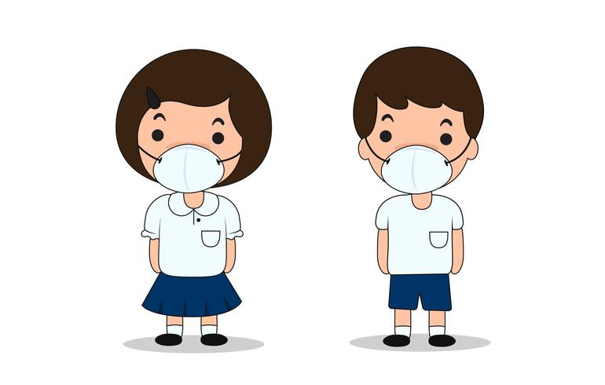
Please Wear Your MASK in LAB
Notes:
To avoid contributing to the spreading of COVID-19, we request everyone of you to wear a mask, or you will not be allowed to participate in the LAB.

Slide 11
Utah CADE Machines
All of you should have access to CADE servers
If not, go apply for one at: https://www.cade.utah.edu/
CADE machines have all the facilities we need
Domain: labX-Y.eng.utah.edu
X = 1, 2, 3, … (# of lab space)
Y = 1, 2, 3, 4, 5, … (machine # of each lab space)
For example, lab2-20.eng.utah.edu
Account: your uid
Password: your uid login password
Remote login using ssh (the easiest way)
ssh -x u6024634@lab2-20.eng.utah.edu
Notes:
The university offers every student the access to computer servers so you can log in to write code and program those machines. The server is called CADE server, C, A, D, E. Everyone from the engineering college can sign up for an account. Please go visit the webpage here, there will be a step-by-step tutorial about how to get an CAD sever account for log in.
This week's LAB will also teach you how to get access to those machines and wirte your first C++ program on the machine.
If you are using MAC or you have a personal Linux machine, you are completely free to use those machine for the programming assignment. Ultimately, you will only need to email or submit your code to TA and it doesn't really matter where you finish those coding. But the university CADE provides you a good place to code.

Slide 12
Software Engineer Job Landscape
Notes:
Any question so far?
Like I said, this class is essentially a software class. Many of you already know, software is becoming more and more important these days. Literally all the jobs require some levels of programming, right? Even though you are doing like chemistry or physics experiments, you need to write programs running simulation so you can avoid spending unnecessary efforts.
this is a map that just shows you the software engineer job opportunities and salary numbers across different states in the united state. The average number is all above 100K and that is actually very high, and this is the average rate for undergraduate. If you are in a really high-tech company and with a MS or PhD degree, the salary number is even higher. For example, a fresh graduate joining Google has a base around 150K. and this is the number I remember two years ago. If it is a financial company, for example, it is even higher. (for example, when I graduate... )
But, money is not always the most important factor in deciding a job. It's all about your personal interests. Otherwise, I won't be here. Anyway, what I am showing here is, software engineer has a good pay, and it is not just about the number, it's where people really care. it's the place where people find interesting and worth investing, because there are real problems and challenges to solve. I worked for IBM, Mentor Graphics, EDA companies, and financial firms. I do think being able to explore different opportunities, especially software companies, is an excellent thing. (share more and discuss with students)

Slide 13
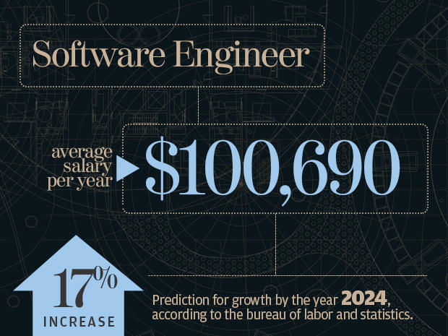
Software Engineer Jobs are Growing!
Notes:
The entire software engineer job market never stops growing. If you look at the salary data, approximately, the salary will grow up by another 17% by the year of 2024. That is a lot. What is means is there are plenty opportunities you can do in terms of software programming. For example, Everybody is using smart phone today and all the apps you are using are computer software running on small devices.

Slide 14
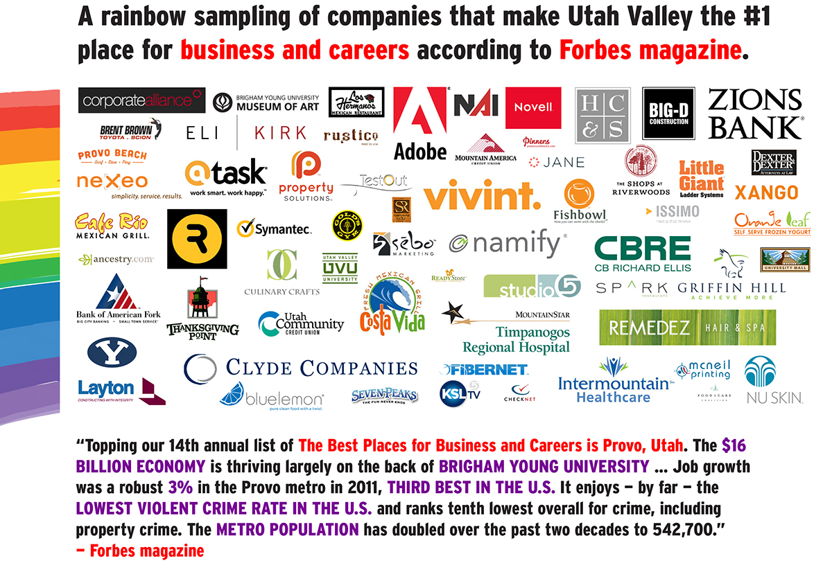
Silicon Slope is right here in Utah!!!
Notes:
Utah here is known for "silicon slope". I want to point out, even though we have a "silicon" in the word, almost all tech companies here are software companies and has little to do with silicon.
...

Slide 15
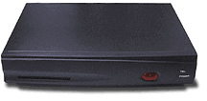

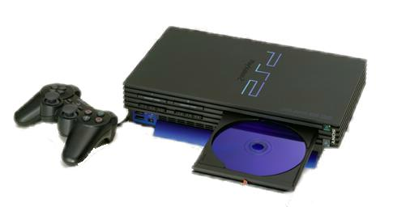

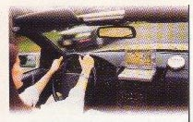
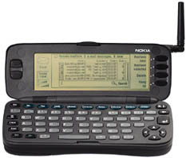

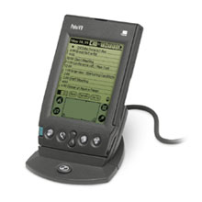
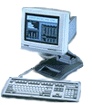
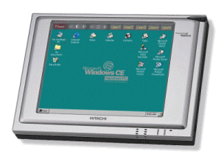


We live in a highly connected world …
Transmission and Interface
AI
Audio and Video
Connecting
Consumer
Screen Phone
Handheld Game
Mobile Phone
Set Top Box
Game Console
Net TV
Auto PC
Smart Mobile Phone
DSC
Handheld PC
PDA
Thin Client
MP3
Computing
Palm PC
Data Processing
Notes:
The underlying reasons is we are living in a highly connected world. I believe everyone of you know how to use internet. Since you are very young, you probably don't know what it was before.
(when I was a undergraduate, the internet was not very common and it is very expensive to get high-speed internet access day back to, like, 2005; if you want to have xfinity internet service, you probably need to pay $200).
Everything is connected by internet today. We use the internet to do almost all kinds of jobs. And a critical component to support this success is the computing. Or in other words, we want to compute data. we want to extract some useful information out of the data.

Slide 16
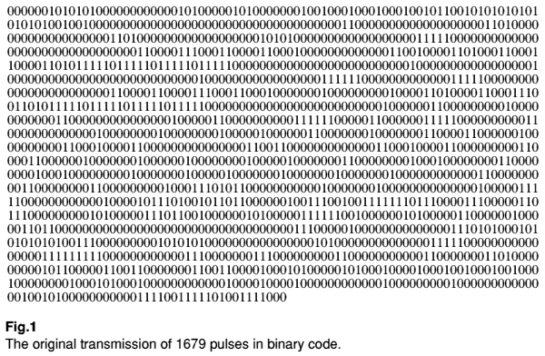
Computing Plays a Key Role
Number
Text
Compute data
Image
Audio
Video
Computer see everything in binary (0 and 1)
Notes:
Data can be numbers (like you phone number), or plain text, images (which are the most commonly used data), audio and video (like youtube). Whichever data you have, we need to compute the data to extract some useful information. We cannot do this by hand, because today's data is so huge and so enormous that we cannot rely on human to do all these things for us. We need to rely on computers because they can compute data much faster than human.
This is indeed very challenging. In the world of computers, everything is digitized. everything is just zero or one. That is what computers see everything in his world. Of course, we must avoid this non-human readable information because no one will be able to interpret zero and one.

Slide 17
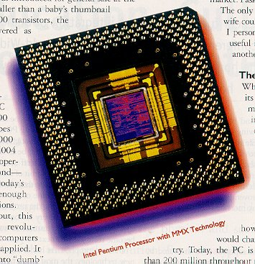
Hardware vs Software
The focus
of this course
main ()
{
say hello;
go to internet;
goodbye;
}
Software
Hardware
Notes:
During the computation, there are two phases, one software and another one hardware. Software is the major layer for people to talk to computer. HArdware is the layer for computer to actually work on your program and run it on computing resources.
By the term you can probably guess, software is more flexible because when you get something wrong, you can just rewrite it, wipe it out and restart everything again.
However, it's a different story on the hardware. When you have a malfunction in hardware, it's million dollars. And the manufacturing process in today's hardware devices are so complicated that you won't afford to have too many errors. This is the fundamental difference between software and hardware.

Slide 18
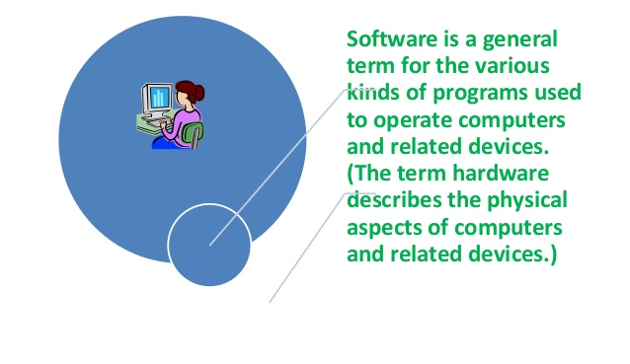
What is Software?
Notes:
What is software? ...

Slide 19
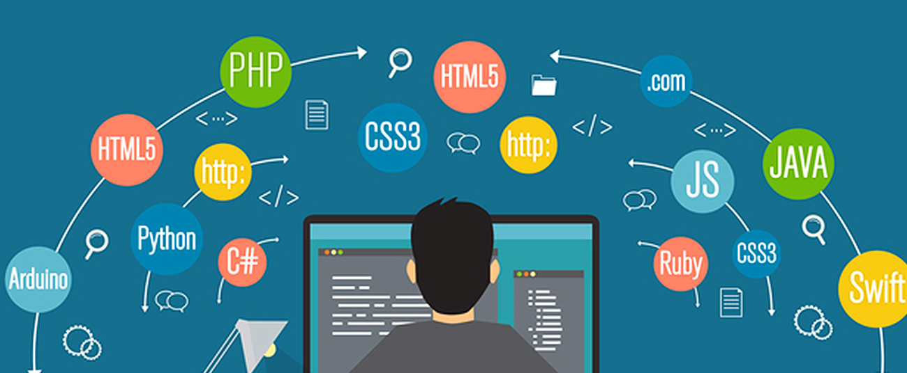
How do We Talk to Computers?
Like we talk to human through “language”
English, Mandarin, Hindi, … => depending on countries
C++, PHP, Python, JS, … => depending on applications
Notes:
In order to operate computers, we must first talk to them. But how do we talk to computers?
Like we talk to human, we use language. We talk to people from different countries using different languages, English, Mandarin, Hindi, and so on, it all depends on countries. For example, if the person comes from the US or the UK, we talk in English. If the person comes from China, we talk in Mandarin.
In computer programming, this "country aspect" translates to "applications". Depending on applications, we have different programming languages, such as C++, Php, python, and javascript. For instance, if you are doing data science, you need quick turnaround time and Python is the best choice. If you are doing computer engineering or electrical engineering, C or C++ is the right language. So, it really depends on the application you target. And the application is driven by the marekt.

Slide 20
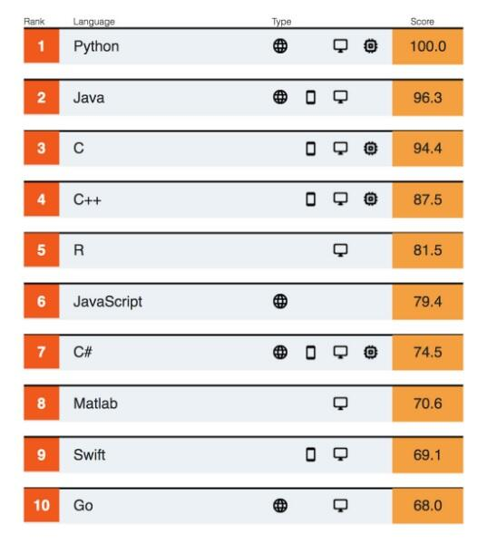
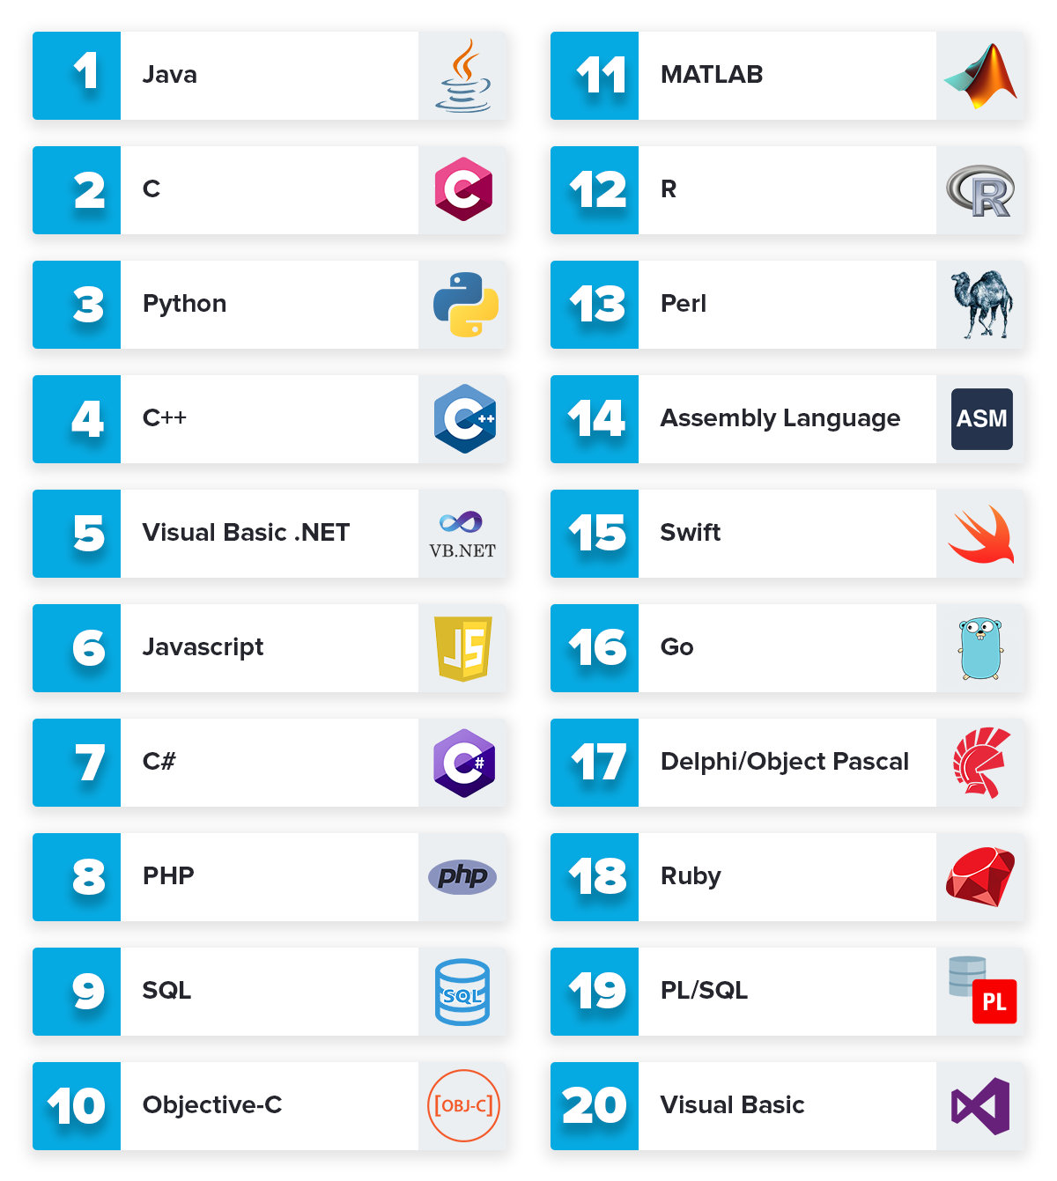
Top 10 Programming Languages
Notes:
This slides shows the top 10 programming languages from multiple resources in 2019. The programming languages on the list are python, C, Java, C++, C#, R, JAvaScript, PhD, Go, and swift. ...
Different tech reports have different results and some of the reports favor their preferred languages. But you can clearly see some of the languages appear in all reports. For example, Java, Python, C, and C++ are definitely among the top 10 regardless of the report you have, because they are just too important to be ignored. Languages like Java, Python, and C++ dominate the entire software industry.

Slide 21
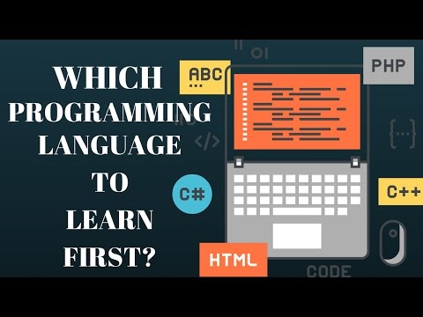
An Often Asked Question
Notes:
The takeaway here is, there are many programming languages, which one should I learn? This is a frequently asked questions by most people who want to learn programming.
Well, the solution usually depends on what kind of applications you want to do. For example, we have the front-end development, like web, smart phone, app, and those applications have their own language zone (they use Python and Javascript).
For back-end development, like the engine that actually supports the things to happen, you know like when you open the browser, there are a bunch of things happening on the background, those are the backend development. And C++ is definitely one of the most popular choices. In fact, most of the electrical and computer engineering problems are written in C++, including all popular AI systems such as Tensorflow and PyTorch.

Slide 22
From an ECE undergraduate’s perspective
It doesn’t matter
Unless you just want to get hacky programming experience and find a job quickly …
Learning “how computers think” and “how you talk to computers through one language” is more important!
Notes:
From an ECE student perspective, it doesn't really matter which language you want to start with, unless you just ...
(follow)
For example, you may be fluent in multiple languages. But, if your speaking is lack of logic, people will have no idea about what you are talking about. You will have hard time in convincing people. It's the same as computer programming. What really matters is your logic, your thinking about how to solve a computational problem. This is what really matters and what you should learn.
Of course, we always need to master at least one programming language. That is the training of the ECE program.

Slide 23
Let’s Do an Example
Find a power of a number
Input: a, b (1 < a, b < 2147483647)
Output: x = a^{b}
a=3, b=4, x=3⁴=81
a=2, b=5, x=2⁵=32
Assume you can only do multiplication one at a time
Naïve method
2¹⁶ = 2*2*2*2*2*2*…*2 total 15 calculations
Can we do better?
Notes:
To give you a better idea about why this logic matters, let's do an example.
(explain)
So, a very simple, naive method will be multiplying a to itself by b times. If I ask you to compute 2 to the 16, you can keep multiplying 2 by 2 for 16 times and that gives you a total of 15 calculations.

Slide 24
Divide and Conquer
Naïve method
2¹⁶ = 2*2*2*2*2*2*…*2 total 15 calculations
A better way as follows:
2¹⁶ = 2⁸ * 2⁸
2⁸ = 2⁴ * 2⁴
2⁴ = 2² * 2²
2² = 2 * 2
We need only 4 calculations!!!
Notes:
Turns out there is a better way to solve this problem. And this is the most basic yet the most important, widely applied technique in computer programming: Divide and Conquer.

Slide 25
How Efficient is it to Compute a^{b}?
Naïve method
# calculations: linear to b
Divide and Conquer
# calculations: log₂(b)
Let’s say n = 2147483648
Naïve method takes 2147483647 calculations (~10-30s)
Divide and Conquer takes only 31 calculations (~1us)
10000000x faster!
Indeed, this is a Goo___ interview question
Notes:
How efficient is it to compute the general case a to the b?

Slide 26
In fact, there is a name for the refined method:
Divide and Conquer algorithm
(used to solve >50% computer science problems, including Google’s distributed system solutions, e.g., MapReduce)

Slide 27
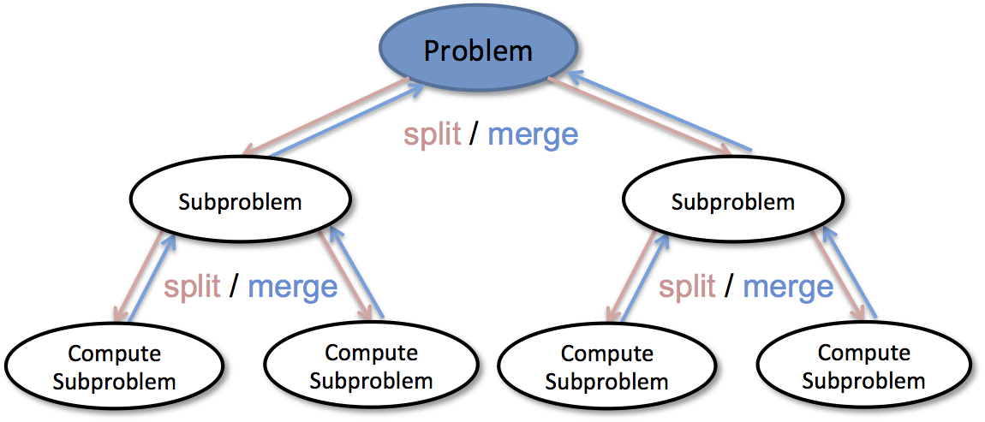
Divide and Conquer is the most basic building block to solve almost all difficult computer problems

Slide 28
Targeted Programming Language
We will be using C++ most of the time
Most large-scale problems are written in C/C++
Most AI backend engines are written in C/C++
Most performance-critical blocks are written in C/C++
C++ is advantageous in
Being both high-level and low-level
Linking to hardware and computer architecture
Understanding memory hierarchy and cache effect
We will talk a bit about Java at the end of the course
Notes:
Now, from this example we just experienced, do you think it matters which programming language you learn? No, it doesn't because the solution I just told you has nothing to do with a programming language but you understand the importance of the mathematical thinking to solve this problem in logrithmic time. Keep in mind, programming language is just a tool for you to solve the problem. What really matters is your idea. Different ideas are going to give you significantly different implementations, some may run forever and others are extremely fast.
In this course, the targeted programming language is C++, because C++ is one of the most important programming languages in the ECE domain.

Slide 29
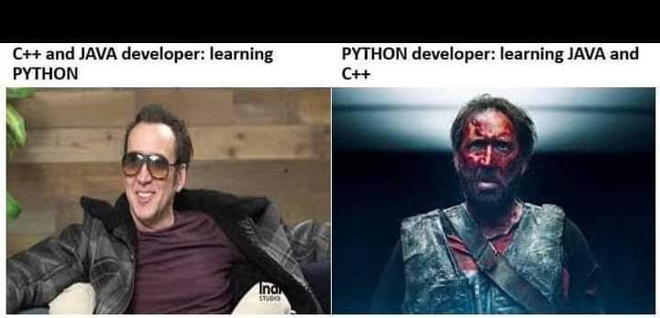
Once You Master C++ …

Slide 30
Summary
Class Logistics
Software engineering
Programming languages
Notes:
u1306576@umail.utah.edu;u1100840@utah.edu;u1231201@utah.edu;u1059119@utah.edu;u1277271@utah.edu;u1279042@utah.edu;u1288871@utah.edu;u1162987@utah.edu;u1149181@utah.edu;u1034348@utah.edu;u1274730@utah.edu;u1309216@utah.edu;u1307344@utah.edu;u1054050@utah.edu;u0906668@utah.edu;u1020513@utah.edu;u1046844@utah.edu;u0934438@utah.edu;u1028034@utah.edu;u1218276@utah.edu;u1205315@utah.edu;u1235021@utah.edu;u0613876@utah.edu;u1194598@utah.edu;u0800167@utah.edu;u1100383@utah.edu;u1313270@utah.edu;u1170639@utah.edu;u1233102@utah.edu;u0441877@utah.edu;u1306569@utah.edu;u1117469@utah.edu;u1053605@utah.edu;u1186007@utah.edu;u1117512@utah.edu;u1015229@utah.edu;u1322203@utah.edu;u1030352@utah.edu;u1030406@utah.edu;u1298265@utah.edu;u1309248@utah.edu;u1134903@utah.edu;u1080280@utah.edu;u1184264@utah.edu;u1255151@utah.edu;u0726957@utah.edu;u1174177@utah.edu;u1165266@utah.edu;u1201859@utah.edu;u1169721@utah.edu;u1337151@utah.edu;u1025911@utah.edu;u1307883@utah.edu;

